Slide 2
Minor Project – I THE STATE EXCURSION PLANNER
MEMBER’S NAME | ROLL NUMBER | SAP ID | BRANCH
Bhoomika Singh | R172219018 | 500077419 | CSE - Big Data
Mohd Ahzam Ausaf | R172219035 | 500077188 | CSE - Big Data
Prabhjot Singh | R172219039 | 500077450 | CSE - Big Data
Shruti Sharma | R172129053 | 500077183 | CSE - Big Data
Under the guidance of:
Dr. Virender Kadyan

Slide 3
CONTENTS
Introduction
Literature Review
Problem Statement
Objective
Methodology
Implementation and Output
Result and Discussion
Conclusion and future scope , Application of the project
References

Slide 4
INTRODUCTION
The goal of the STATE EXCURSION PLANNER is to give tourists the most efficient and optimal path possible, thus, saving the travelling time.
The algorithm starts with the user selecting the journey's starting location, and then moves on to the next spot closest to the starting place.
This iterative loop continues until all of the nodes have been covered and then ends when it returns to the start point.

Slide 5

Tourists wanting to explore the beautiful tourist attractions are the primary target group for this project.
By using this to schedule tours, you can save up to 80% on planning time.

Slide 6
LITERATURE REVIEW
The study of various TSP-solving algorithms.
Discussion of recommended technique and selection of the most suitable algorithm for our use case.
Identifying the most popular tourist attractions in Uttarakhand and select the top fourteen to be included in our list of recommendations.
Reference: https://www.holidify.com/state/uttarakhand/top-destinations-places-to-visit.html

Slide 7
PROBLEM STATEMENT
PROBLEM: Designing a route-map like system confined to the state, Uttarakhand, to ease the problems that travellers who are new to the state are facing and provide them with a standardized optimal route to reduce travel time.
RELEVANCE: Tourists that want to see tourism attractions are the primary target group for this initiative. Tourist guides, planners, and businessmen who want to increase the quality and equity of their general trip guide would be the primary benefactors. The project's problem statement is based on the well-known Travelling Salesman Problem, and it employs the Nearest Neighbor Algorithms to determine the most efficient and quickest path to the target destination.

Slide 8
OBJECTIVE
To provide the user with a list of tourist spots that he can choose from to visit in Uttarakhand.
To find the best route possible that covers all the spots a person wishes to visit in Uttarakhand back to the very location they started their trip from.
To enhance the experience of the tourist.
To give tourists a brief idea of the places that they might visit during their travel.

Slide 9
METHODOLOGY
• Input: Distance matrix between a set of cities
• Output: A minimum-length route that visits each tourist place exactly once before returning to the starting point.
• Algorithm: Bellman - Held - Karp Algorithm
• Technique: Dynamic Programming Approach
• Time Complexity: O(2^{n} x n²)
• Space Complexity: O(n x 2^{n})
• Data Structure: Adjacency Matrix to help us keep track of the distances between nodes in our graph.
• Data Set: Distances between each pair of various tourist spots in Uttarakhand as well as from Dehradun Railway Station, Jolly Grant Airport and Dehradun ISBT.

Slide 10
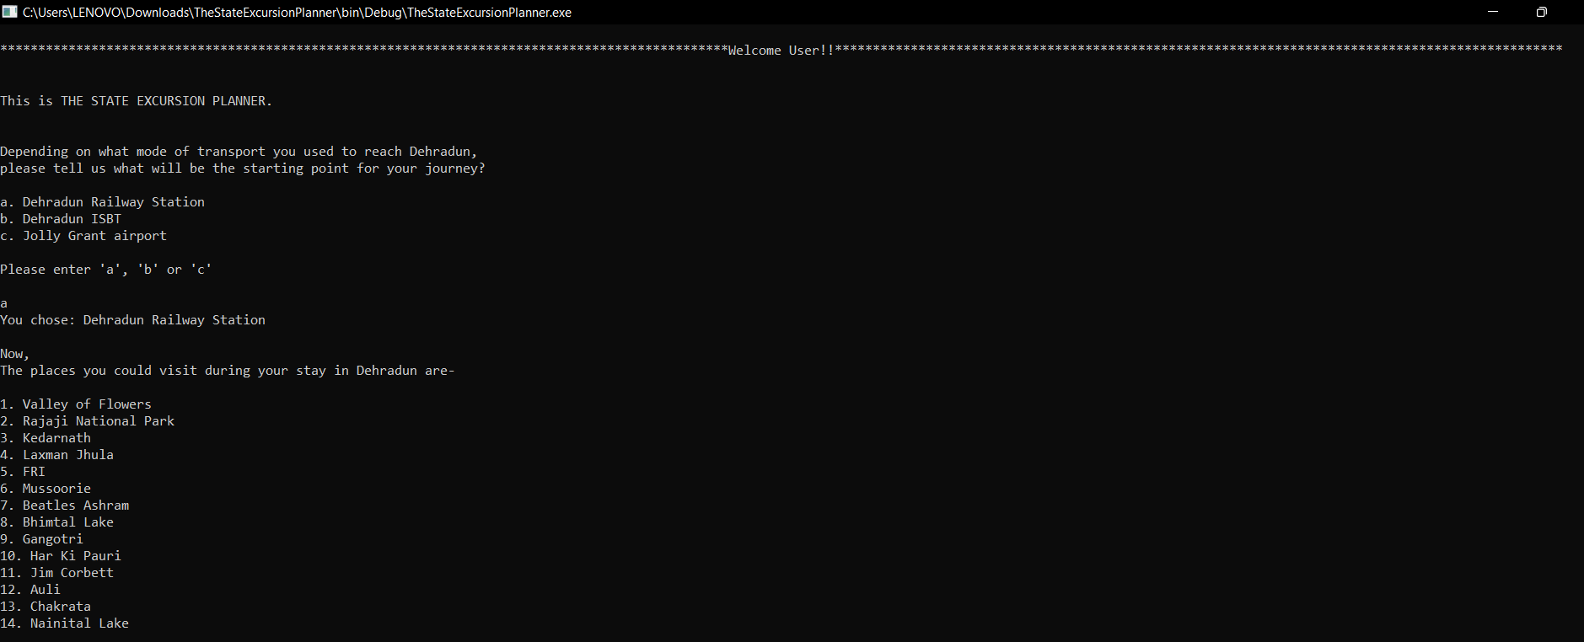
IMPLEMENTATION AND OUTPUT

Slide 11
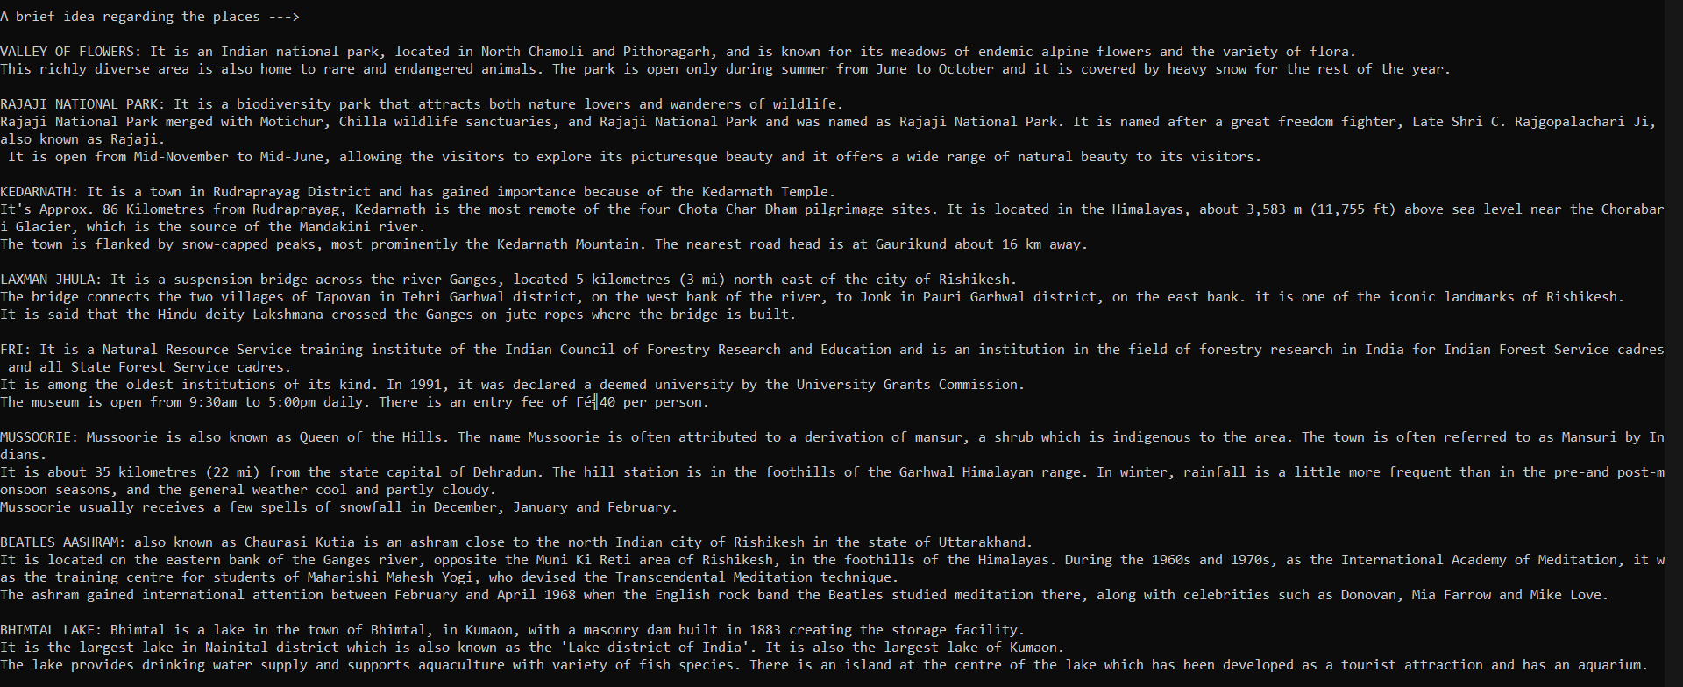

Slide 12
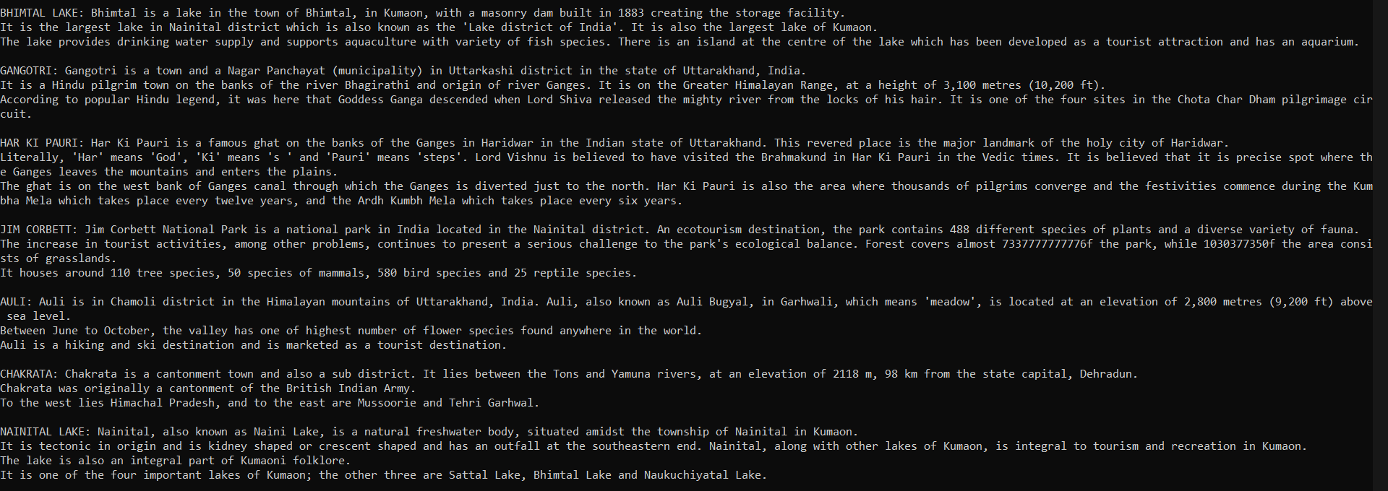

Slide 13
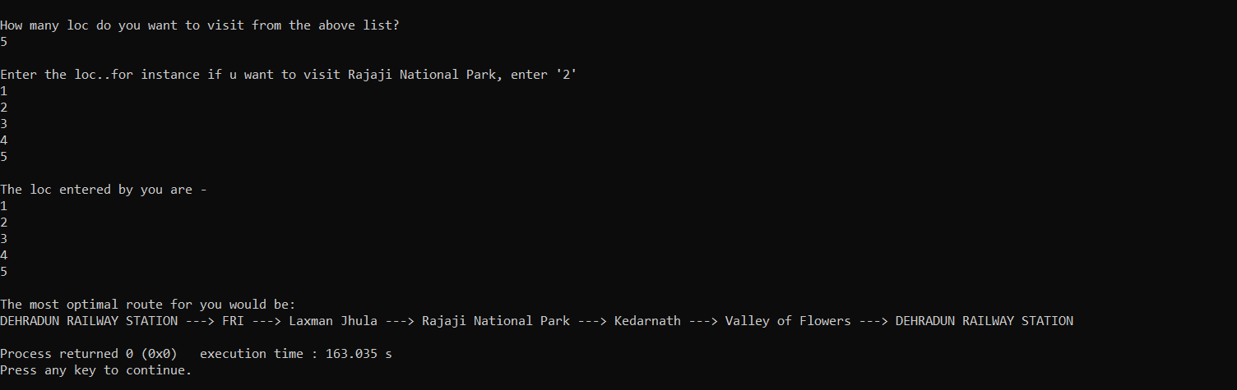

Slide 14

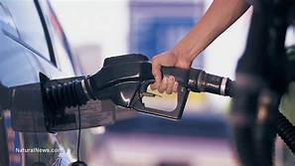
RESULT AND DISCUSSIONS
After the analysis of the State Excursion Planner, we can deduce that the result retrieved from the algorithm will be very efficient and can ease and minimize the daily problems Travellers face.
1. Time saver:
Providing Travellers with the optimal option for their journey.
2. Minimizes Fuel Cost and Vehicle Maintenance Expenses:
Fuel consumption can be reduced by using highway miles instead of surface streets with stop and starts, and by using an algorithm rather than guessing to identify the most efficient route. As result, there is less wear and tear on the vehicle, as well as cheaper fuel expenses.

Slide 15
CONCLUSION AND FUTURE SCOPE
Tourist guides, planners, and businessmen who want to increase the quality and equity of their general trip guide would be the primary benefactors. By using this to schedule tours, you can save up to 80% on planning time and significantly on fuels and driver pay, resulting in better tour experiences.
Over the projected period of 2020-2025, the route optimization software market is expected to develop at a CAGR of 10.9 percent. With automated multi-stop route planning capability, State Excursion Planner route helps travellers fulfill their planning in less time and removes manual hours of preparation.

Slide 16
APPLICATION OF THE PROJECT:
The State Excursion Planner is easy to use hence can be helpful for each and everyone who wishes to travel and explore new places.
It can be used by travellers to find the best path for their trip without asking around from local people which would save a lot of their route planning time.
It can be used by Tourist Management Systems and tourist guides, and they can modify it accordingly to show their visitors the approximate distance, time and money they would require for their trip.
It can also be used by businessmen to plan their business trips in the best way possible that saves their time and travel expenditure.
The travellers can also modify the destinations easily according to their needs.

Slide 17
REFERENCES
Lenstra, J. K., & Kan, A. R. (1975). Some simple applications of the travelling salesman problem. Journal of the Operational Research Society, 26(4), 717-733.
Rai, K., Madan, L., & Anand, K. (2014). Research paper on travelling salesman problem and it’s solution using genetic algorithm. International Journal of Innovative Research in Technology, 1(11), 103-114.
Lai, F., Szczecinski, M., So, W., & Fernandez, M. Improving Operations with Route Optimization.
Held, M., & Karp, R. M. (1962). A dynamic programming approach to sequencing problems. Journal of the Society for Industrial and Applied mathematics, 10(1), 196-210.
Karkory, F. A., & Abudlamola, A. A. (2013). Implementation of heuristics for solving travelling salesman problem using nearest neighbour and minimum spanning tree algorithms. International Journal of Computer and Information Engineering, 7(10), 1524-1534.

